Slide 1

Invoice reading using ML
Automation created by Henry Wang
April 2021

Slide 2
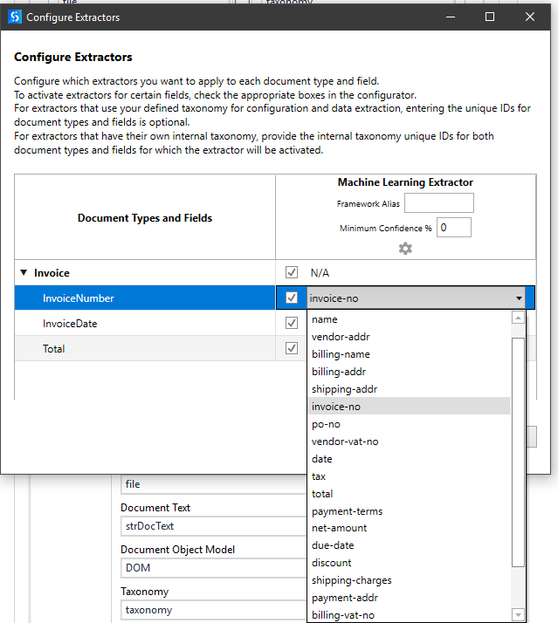
Functionality
Document type recognition and data extraction
This process uses machine learning modules to read invoices and extract all relevant data. This enables the automation to extract data regardless of the format of the invoice.
It functions by identifying one of the three following words: “invoice”, “faktura”, “kreditfaktura” to define the document. Please note that these words can be manually input.
The default automation extracts invoice number, date and total amount. The extracted values can also be edited to fit the purpose of the user.

Slide 3
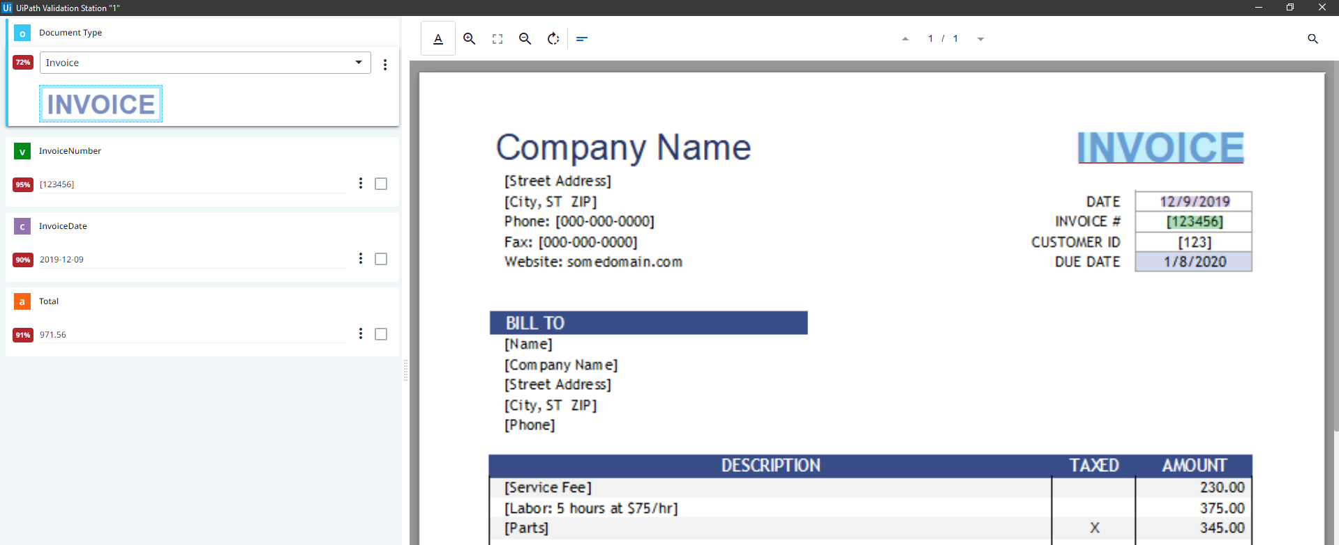
Functionality
Validating the data
The automation enables the user to validate the data extracted through a validation step, see image to the right.
Please note that this step can be skipped by disabling the “present validation station” activity in the sequence of UiPath.

Slide 4
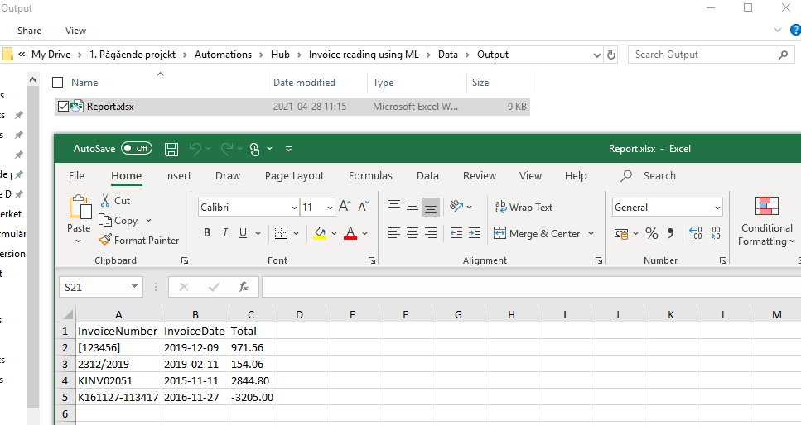
Functionality
Saving the data to an excel spreadsheet
The extracted data is saved to the file path “Data\output\report.xlsx”.

Slide 5
Notes
Three packages needs to be installed to run this automation:
- UiPath.DocumentUnderstanding.ML.Activities
- UiPath.IntelligentOCR.Acitivities
- UiPath.OmniPage.Activities
Please also note that a custom ApiKey needs to be created. Do this at http://platform.uipath.com/ under admin -> Licenses -> Robots & Services -> Document understanding
Author: Henry Wang
Please don’t hesitate to contact me on LinkedIn for any inquiries: https://www.linkedin.com/in/henry-wang-/

Slide 6
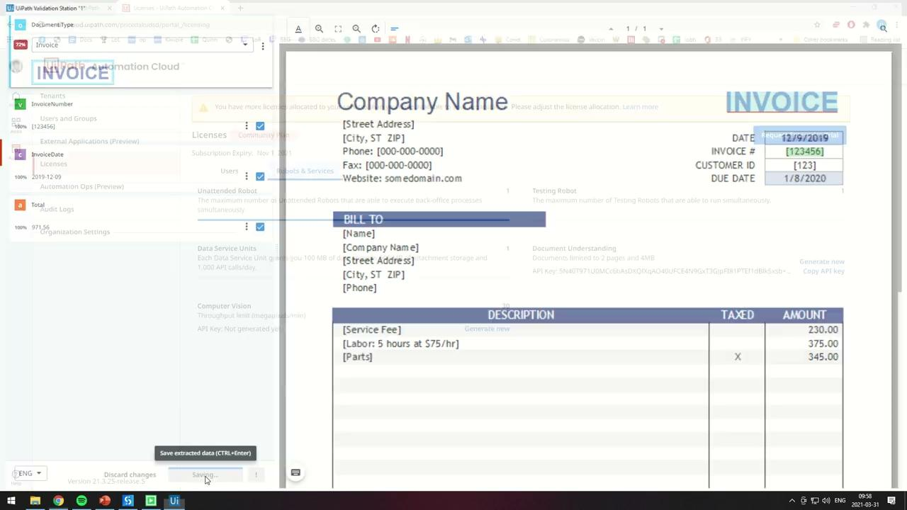
Demo

